Slide 1
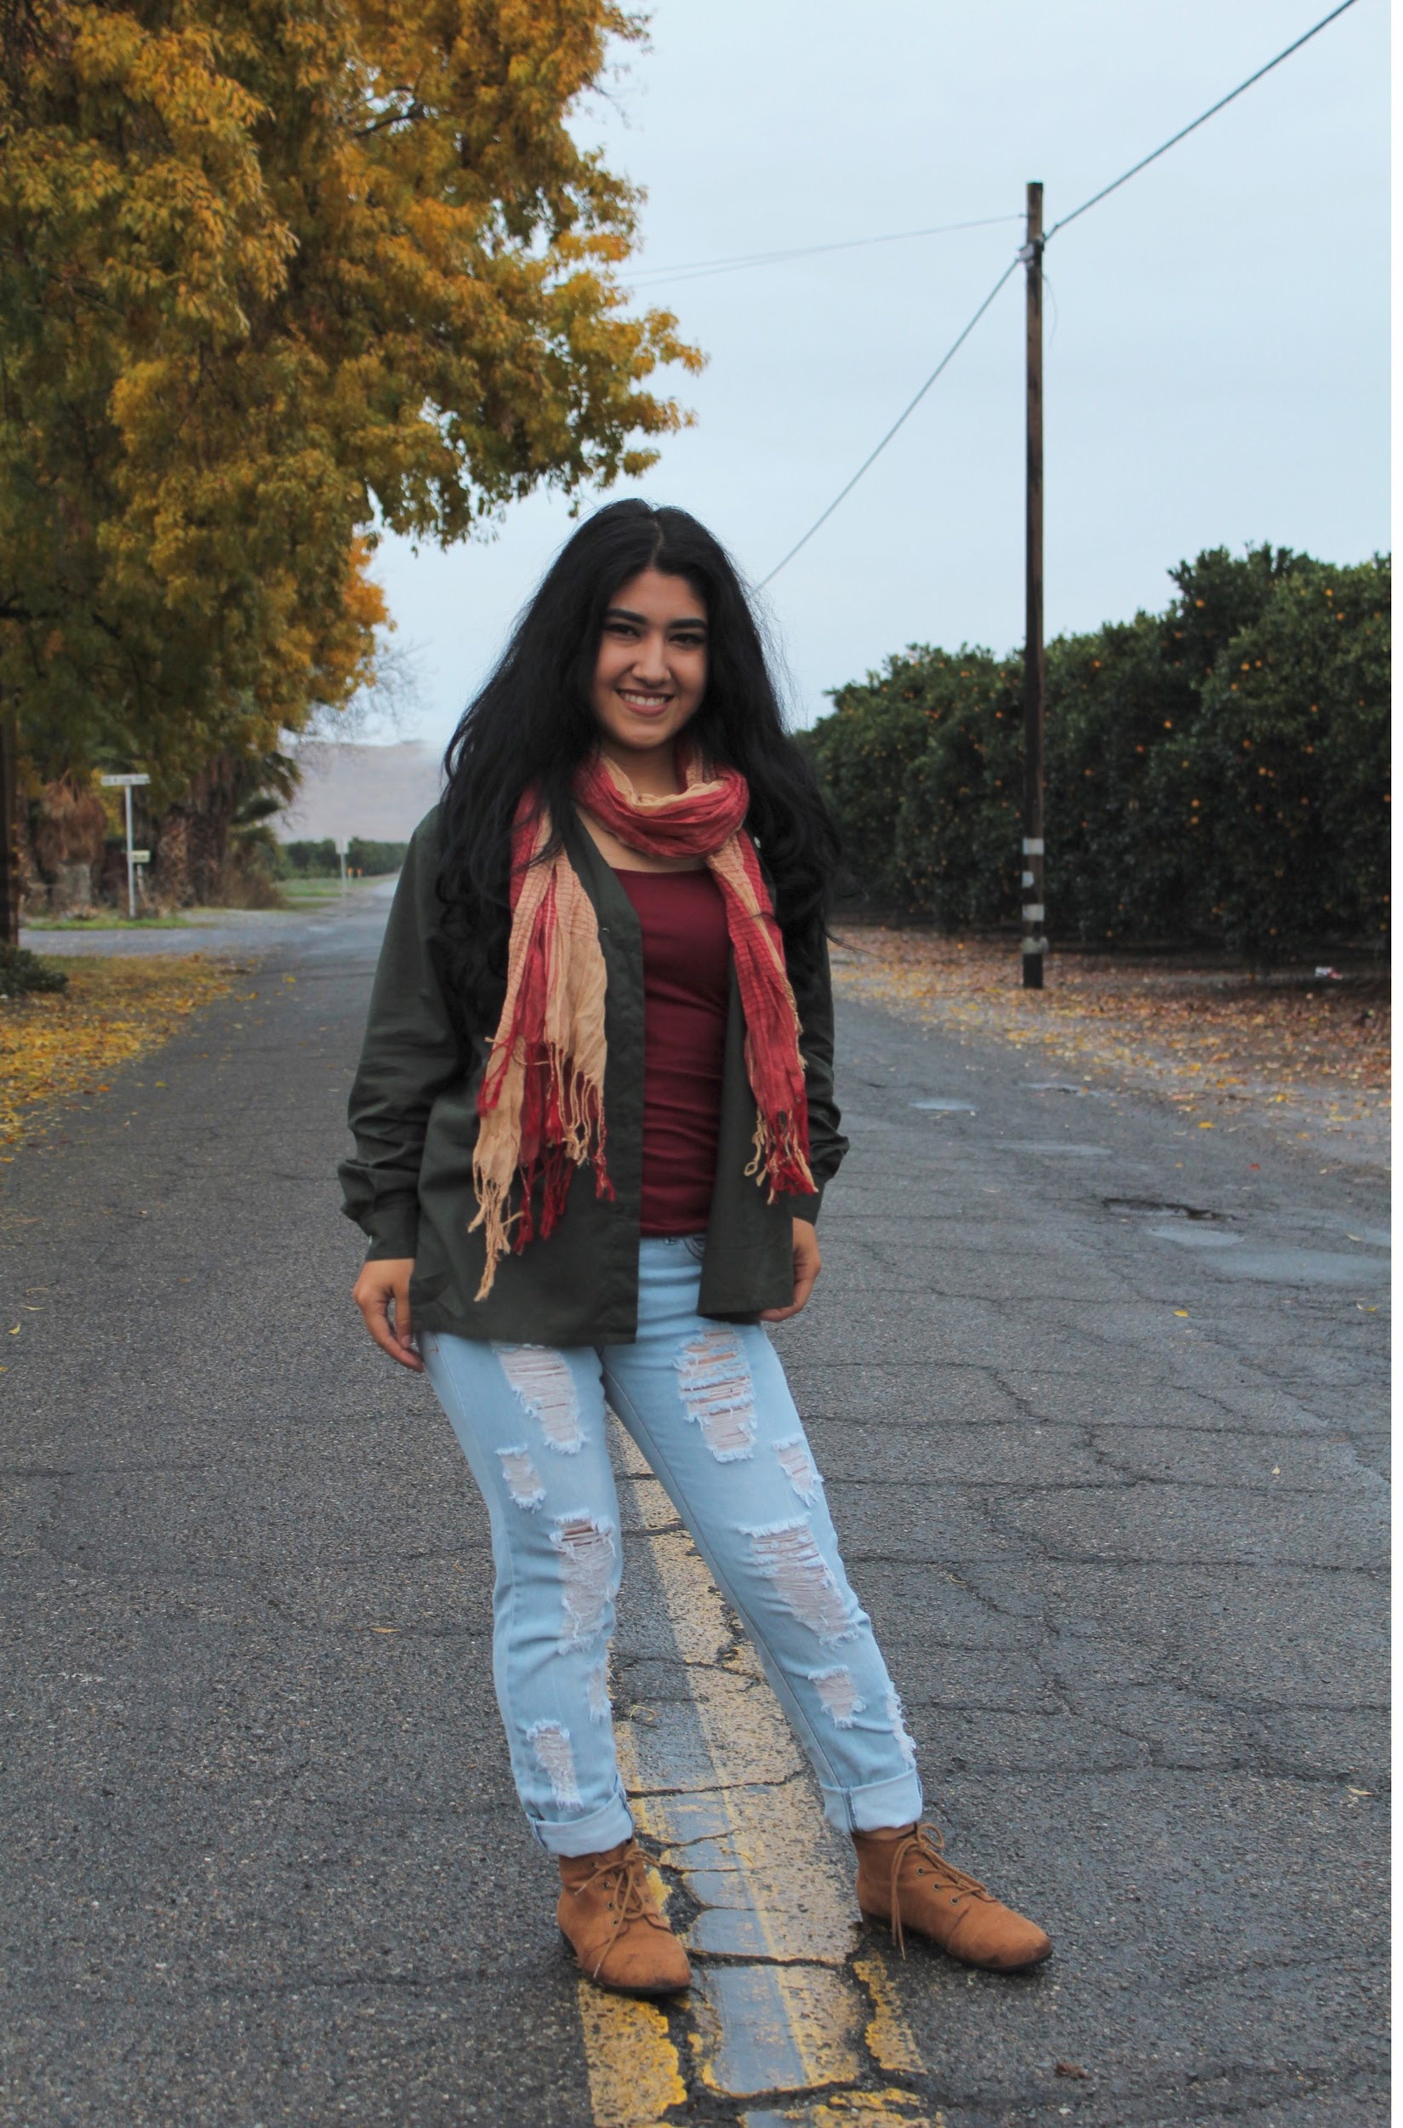
Ambriehl Ruelas
2017 Senior Exit Interview

Slide 2
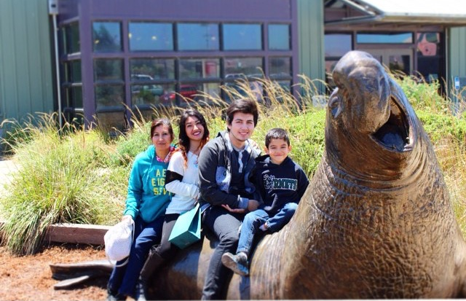
About Me
Guillermina and Adrian Ruelas
2 brothers
Born in Lindsay
May 26,1999
Drawing
Personal Challenges
Brother

Slide 3
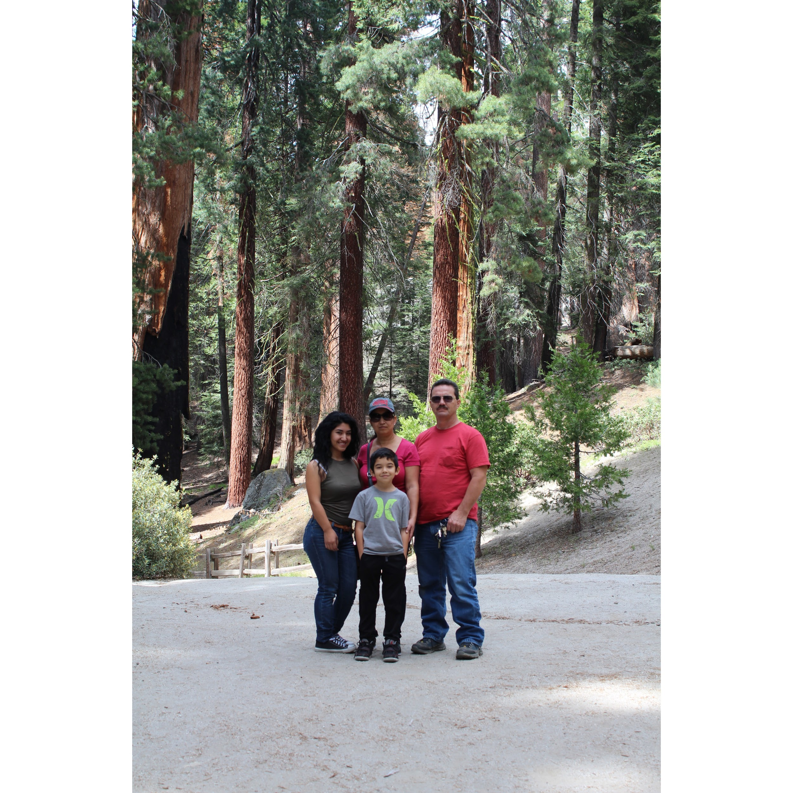
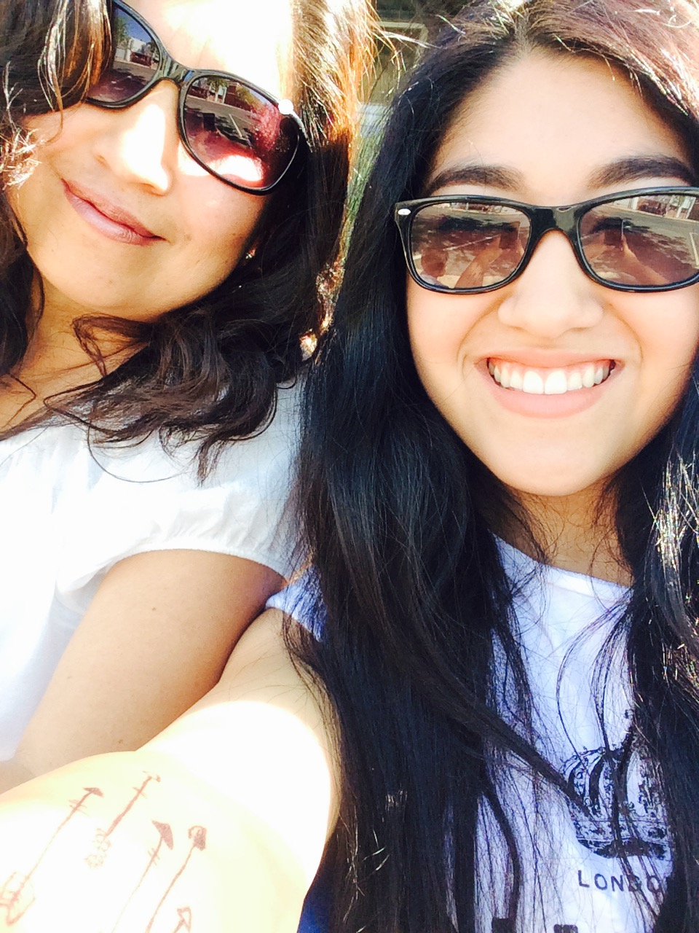
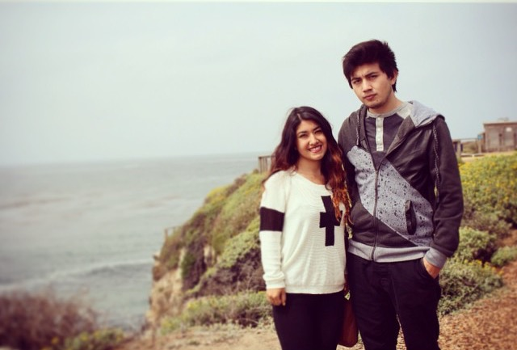

Slide 4
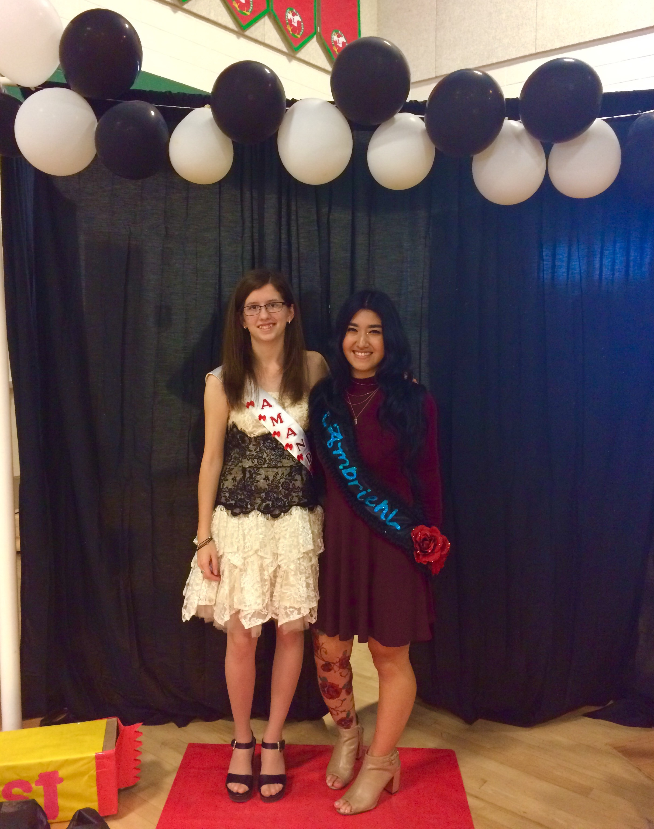
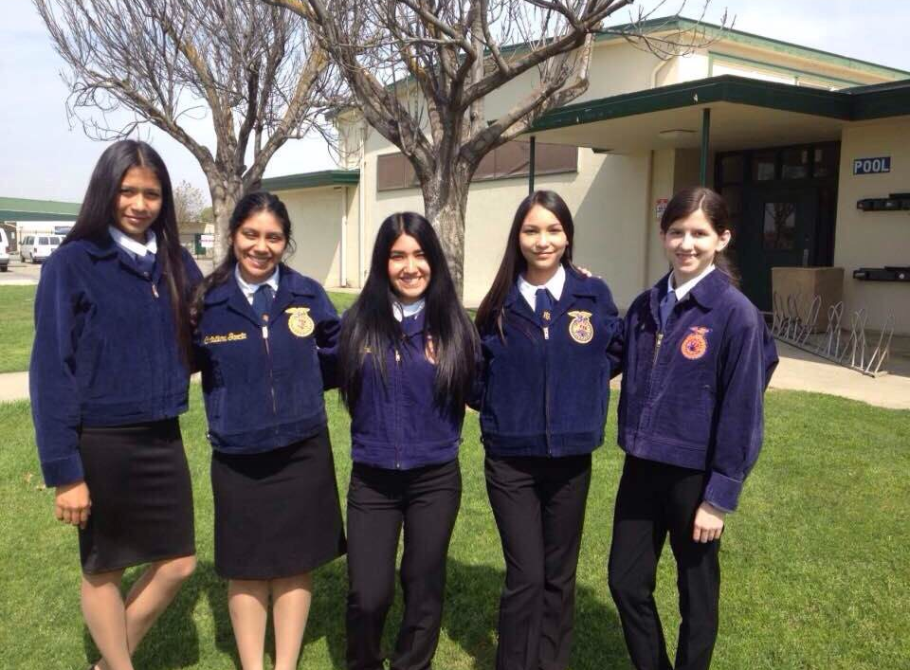
High School Experience
FFA
Art Club
Homecoming
Soccer
Guitar Recital

Slide 5
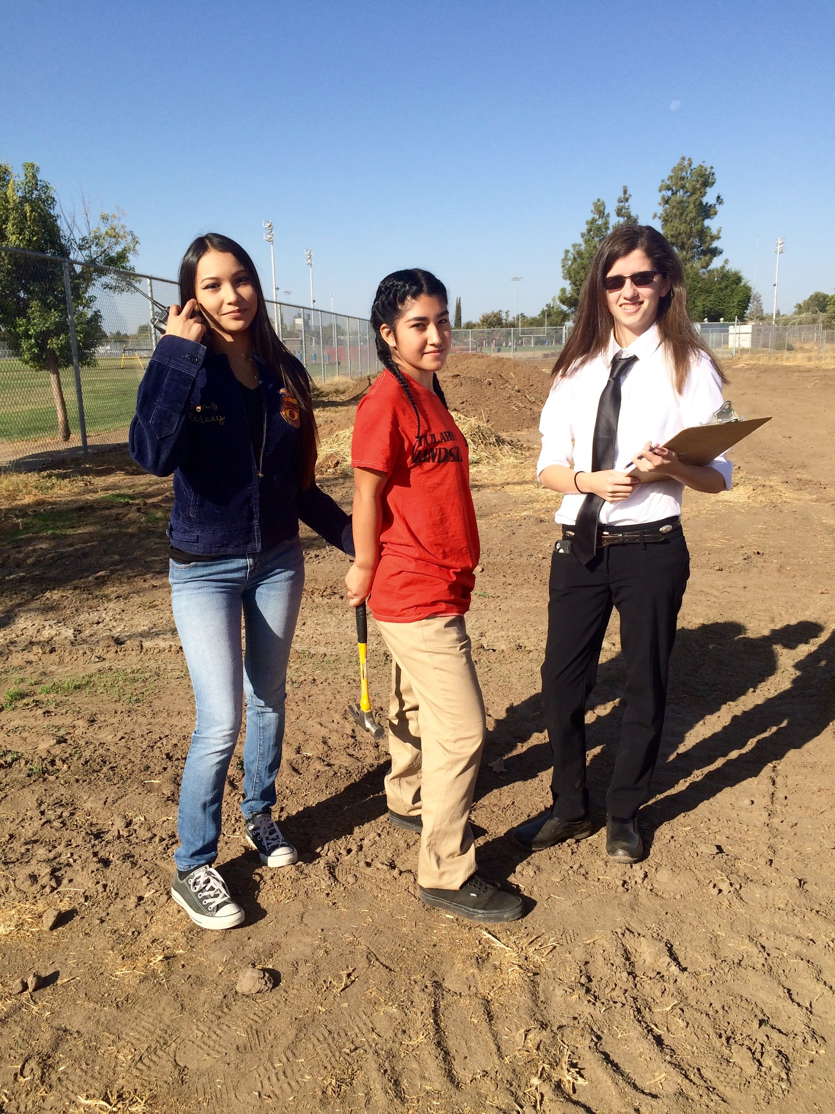
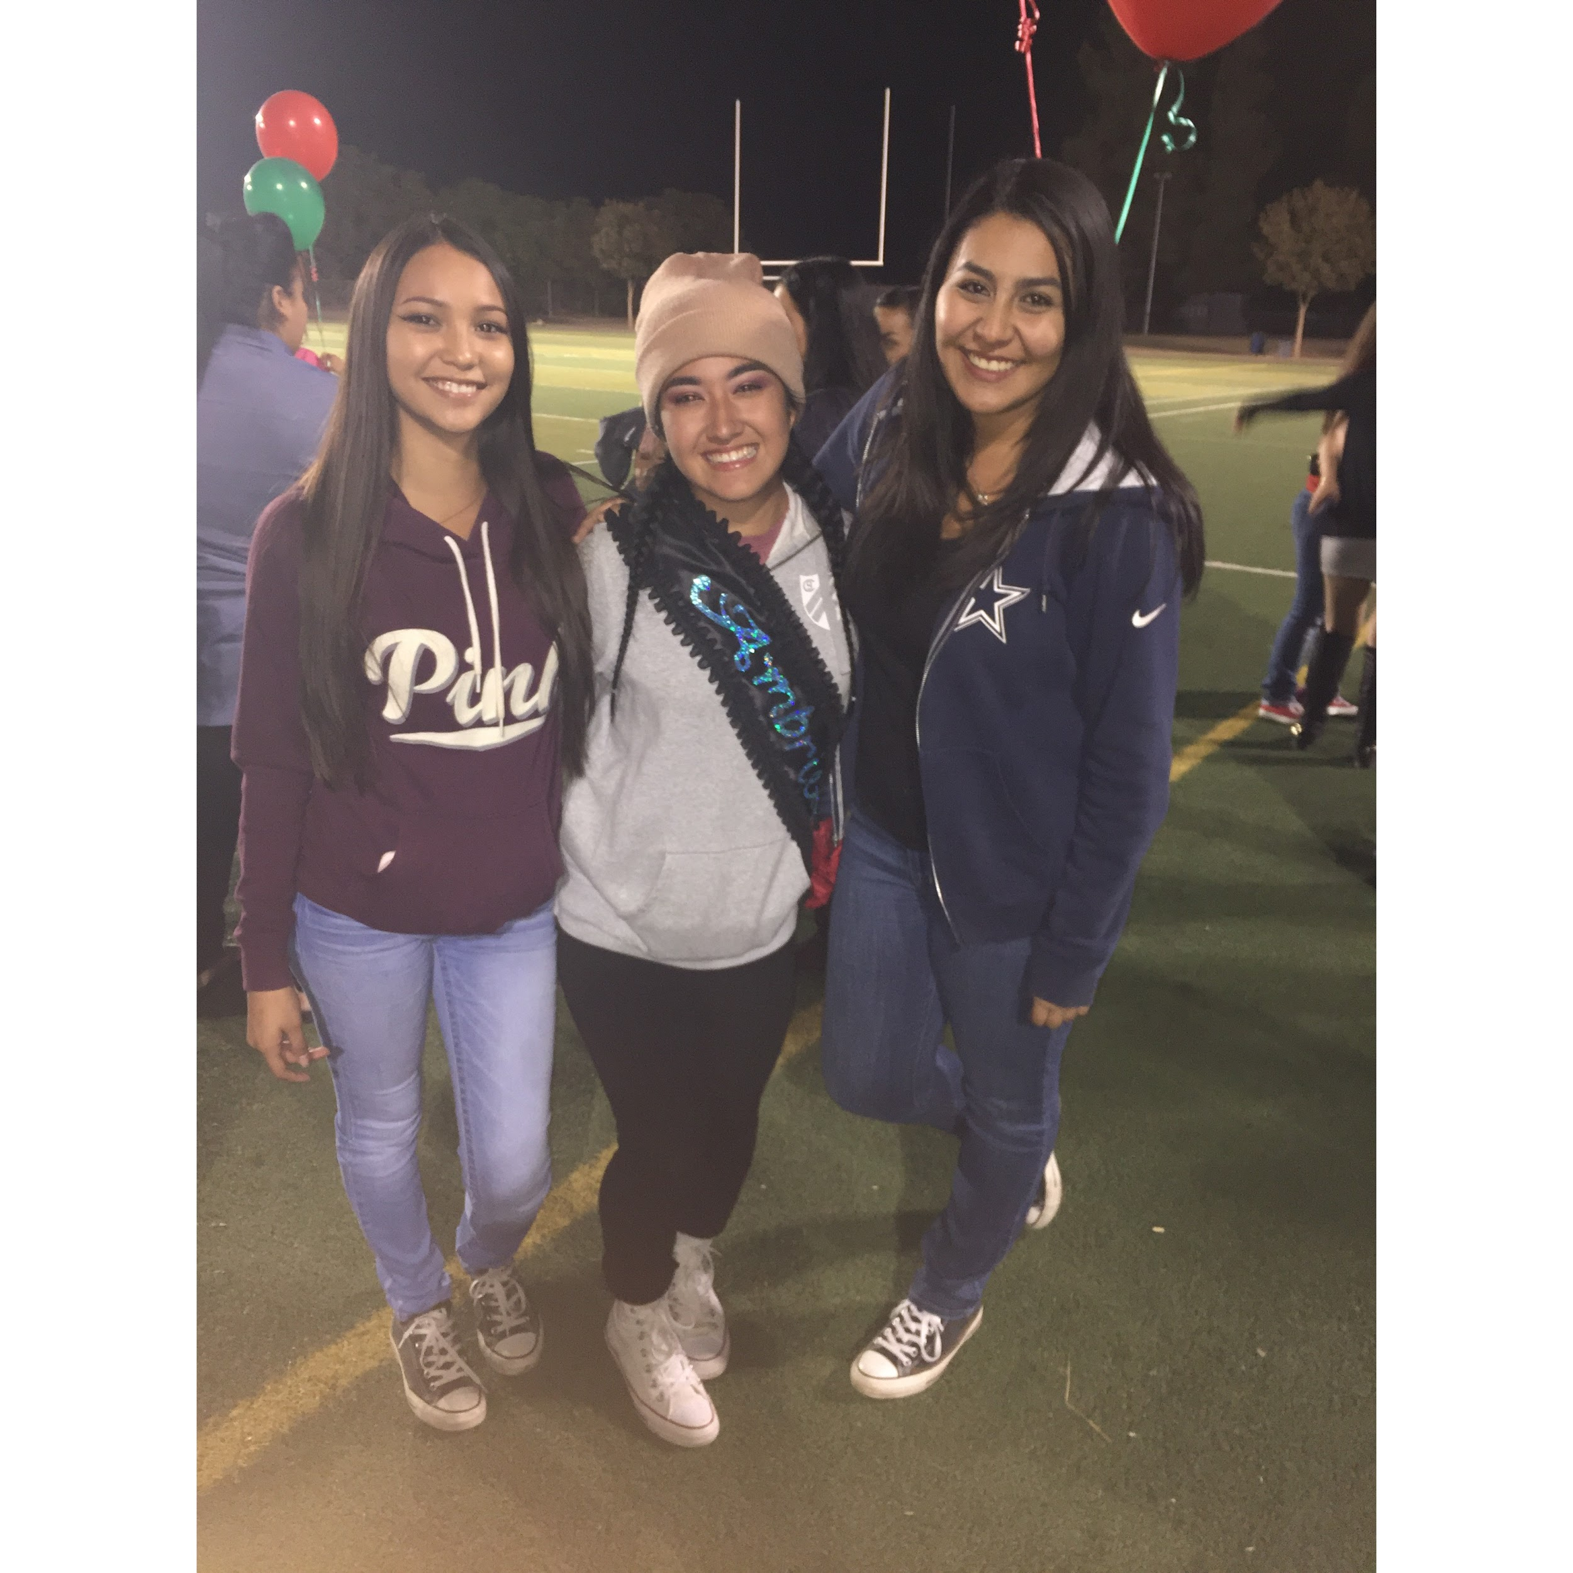

Slide 6
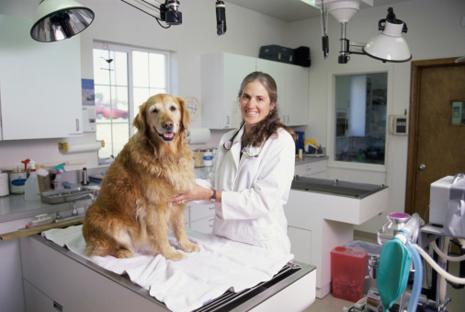
Job Shadow-Vet Clinic
Veterinarian
Neutered
Anastasia
Daily check ups
Nice environment
Positive
Friendly

Slide 7
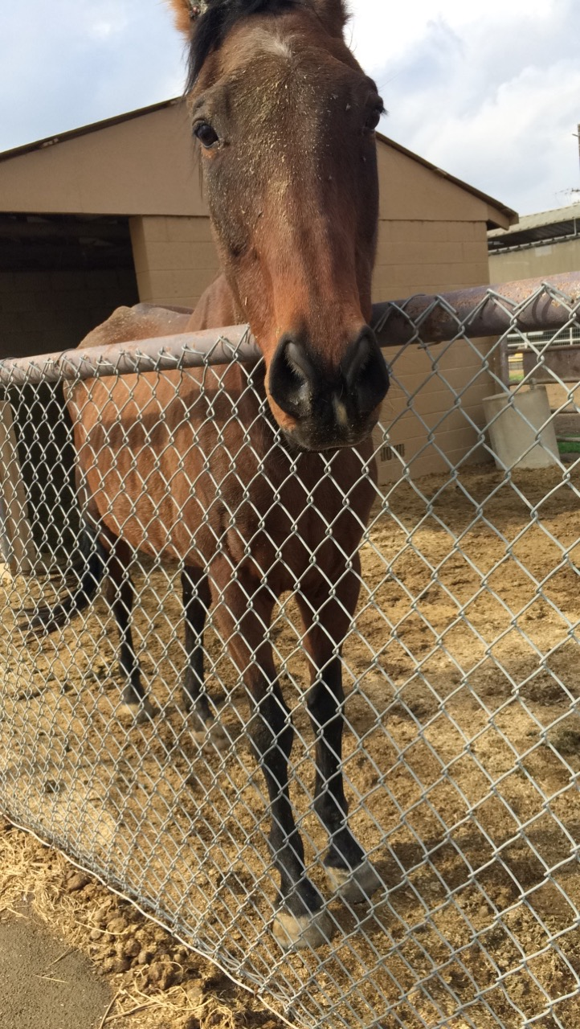
Pathway-Agriculture
Love animals
Want to be a vet
Save animal lives
Changed career to art
What I’ve Learned:
Animal care
Public speaking

Slide 8
Post-High School Plans
Major in Art
Animation
Porterville college
Cal State LA
AA in Art
close to home
spend less money
won’t have to pay rent
Parents help
FAFSA
Disney

Slide 9
Leaving LHS
Influential Teachers:
Mrs. Gregory & Miss.Medina
How LHS shaped me:
Independent student
Resourceful
Value my time
Can’t slack off

Slide 10
Thank you for your time
Any Questions?

