Slide 1
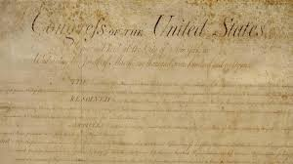
Amendment 9
By Ambriehl Ruelas p.3

Slide 2
What is Amendment 9?
“The enumeration in the Constitution of certain rights shall not be constructed to deny or disparage others retained by the people”
In other words the 9th amendment states that there are other rights that may not be on the constitution but still pertain to the people.
Even if It's not stated , doesn't mean they can be violated.

Slide 3
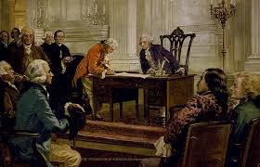
When was the 9th amendment added?
The 9th amendment was added on September 5, 1789 by the Congress and, ratified on December 15,1791.

Slide 4
How and why was the 9th amendment added?
At first, when the 9th amendment was created, they first sent it out to the people so it could be voted on. Anti-Federalists argued with Federalists about weather they should add a Bill Of Rights but were afraid that it would only specify what the government couldn't do. Therefore because of these arguments, Virginia Ratifying Convention proposed an amendment that would limit the government's power.

Slide 5
How and why was the 9th amendment added?
The 9th amendment was also added because it prevented the power from the government from increasing. All the other amendments talked about what the government could specifically not do, but there were many other rights they would be able to violate. So to ensure that the rights detailed in the Constitution and Bill Of Rights were not the only rights, they added the 9th Amendment.

Slide 6
Why is the 9th Amendment Important?
The 9th amendment is important because it refers to many rights that still could not be taken away by the government. Even if it's not written down in The Bill Of Rights, you still have a right to do it.

Slide 7
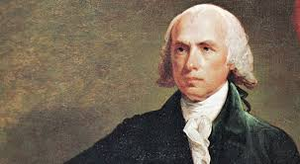
Who added the 9th amendment?
In 1789, a young man named James Madison was named the “Father of the Constitution” He brought up the Bill Of Rights and created the 9th Amendment. He also wrote a rough draft of the Constitution and soon became president in 1808.

Slide 8
Issues with today:
In today’s society, the 9th amendment has been overseen in many ways. Citizens have fundamental rights in which have not been listed in the Bill of Rights. These rights are being violated:
The right to marry whoever you want (Gay Marriage)
Abortion
Right to die
The right to an adequate education
The right to travel freely in and out of the state
The right to refuse unwanted medical treatment

Slide 9
Issues with today
In today’s society, to be able to travel in and out of state freely has been violated. We no longer can just drive out of the state without papers, being a citizen or permission. We are required to sign papers just to move to another state but according to the 9th amendment, being able to travel freely is one of our natrual rights.

Slide 10
Issues with today:
One of the most common issues that has been happening in today’s world, is being able to marry whoever you want. In many states, they restricted gays from being able to marry. According to amendment 9 though, it’s our right to marry whoever we want. We shouldn't have to be told who we can and can’t marry. On June 26 though, they finally passed the law that gays could marry in all 50 states.

Slide 11
Issues with today:
Another main issue that has always been occurring is abortion. Many people go against it, whiles others go for it. Mothers who have aborted though, have been sent to jail. In my opinion, i think abortion is wrong but it's also our natural right. It's one of our rights from the 9th amendment.

Slide 12
Work Cited Page
Farber, Daniel. "'Silent' Ninth Amendment Gives Americans Rights They Don't Know They Have." Alternet. 23 Apr. 2007. Web. 9 Sept. 2015. www.alternet.org/story/50404/the_’silent’_ninth_amendment_gives_americans_rights_they_dont_know_they_have
"Kids." Ninth Amendment . Web. 9 Sept. 2015.
Kids.laws.com/ninth-amendment
"9th Amendment." : Construction of Constitution. Web. 9 Sept. 2015.
www.goverment-and-constitution.org
"James Madison Biography." Bio.com. A&E Networks Television. Web. 9 Sept. 2015.
www.biography.com/people/james-madison-9394965

